Slide 1
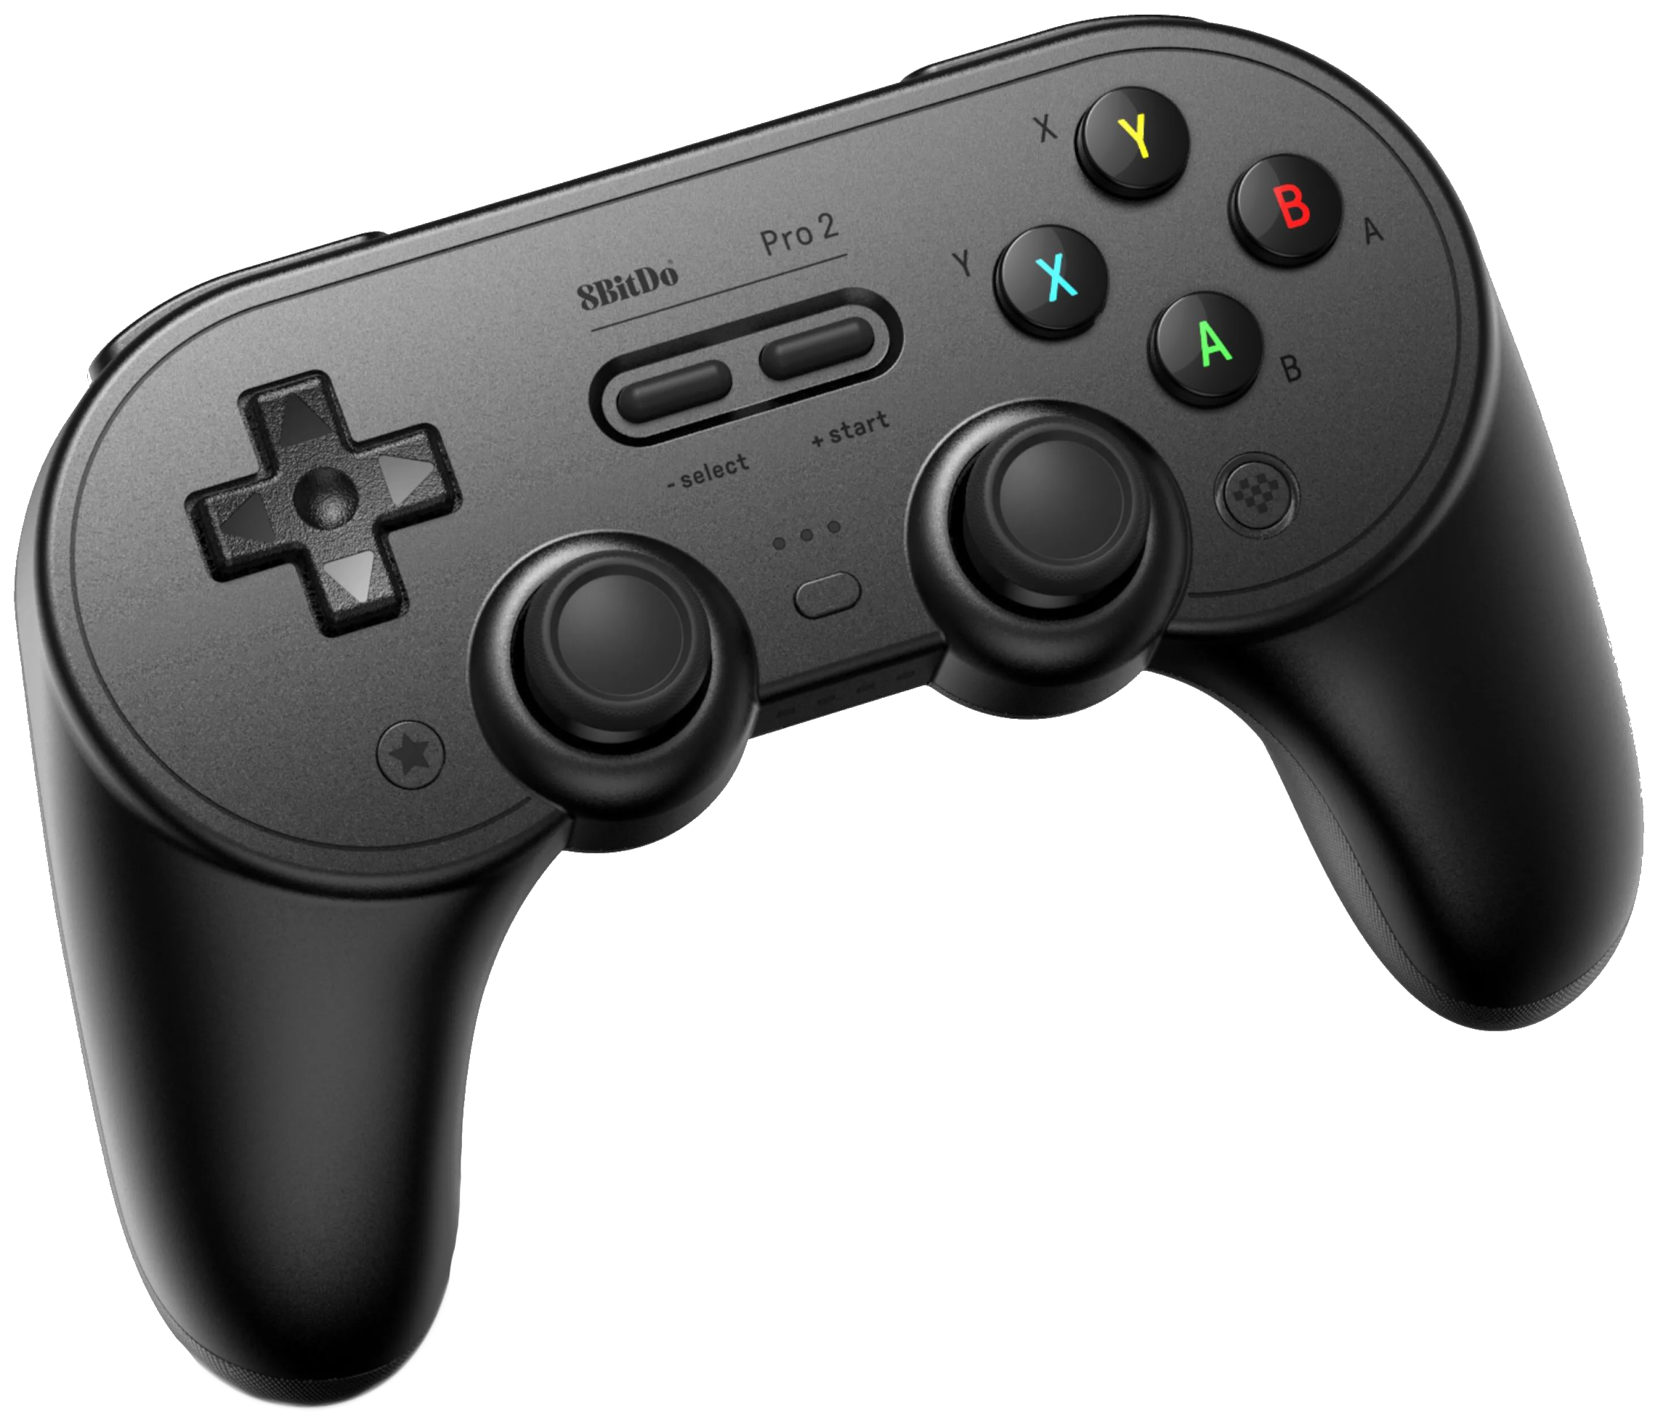
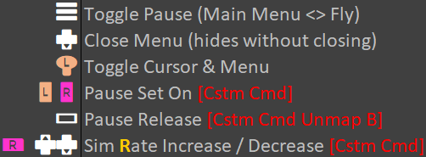
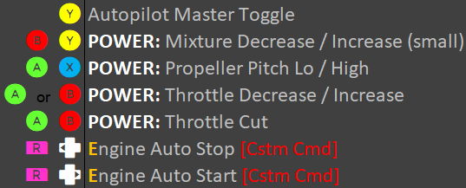
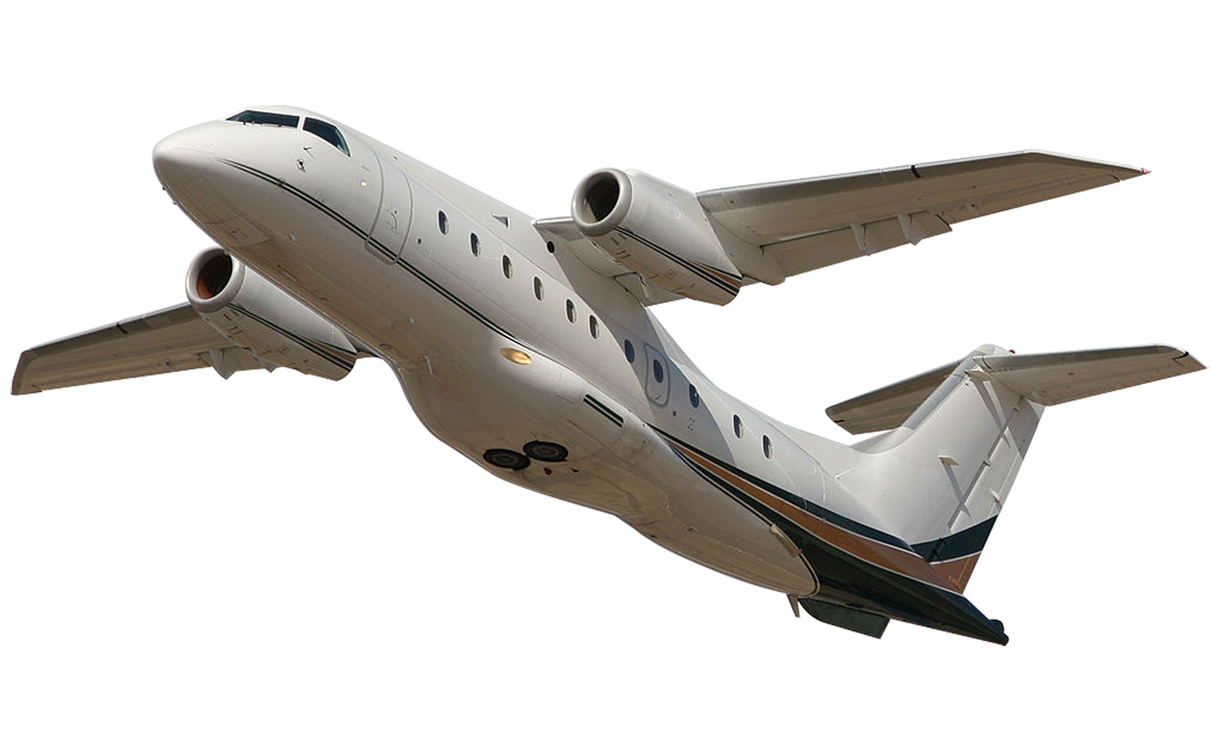
Flight Controls
Brakes & Lights
Pause / Menu / Sim Rate
Throttle
FLYING
flightsimpics.com

Slide 2
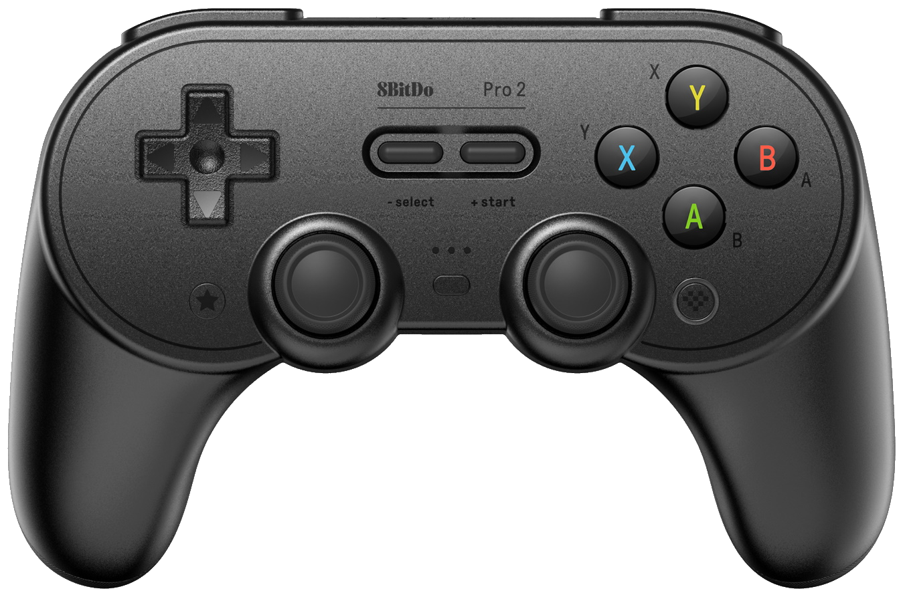
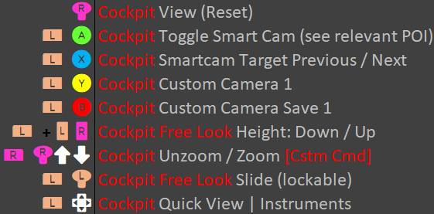
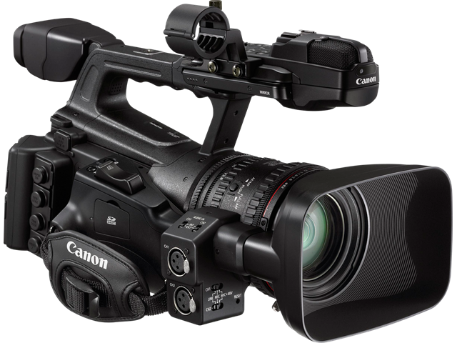
CAMERA
flightsimpics.com

Slide 3
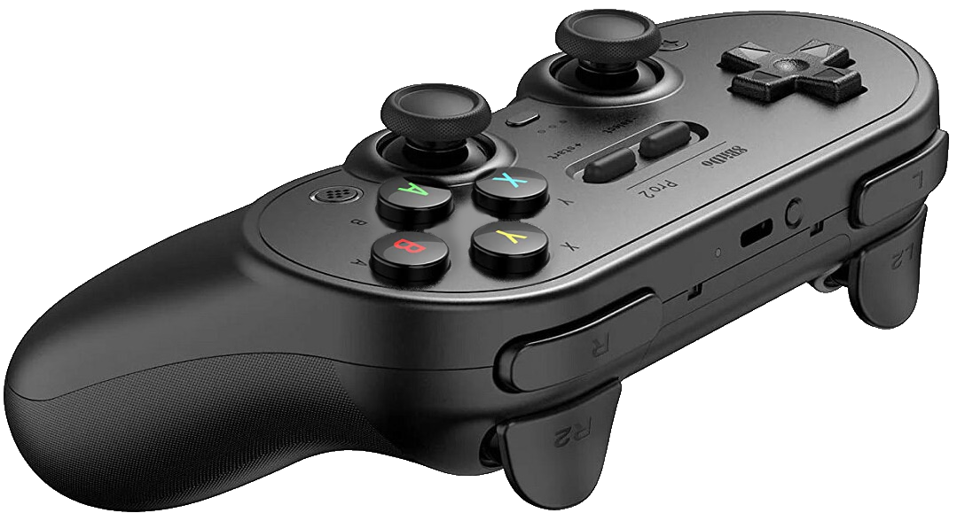
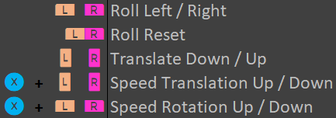
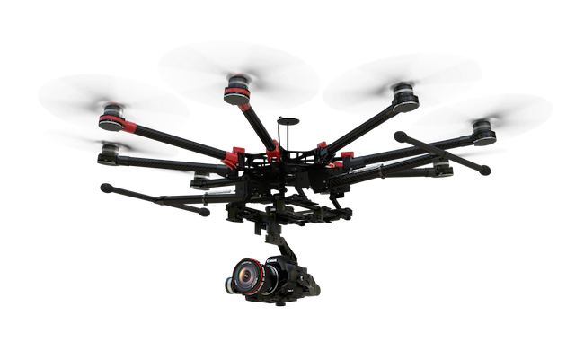
CAMERADRONE
flightsimpics.com

Slide 4
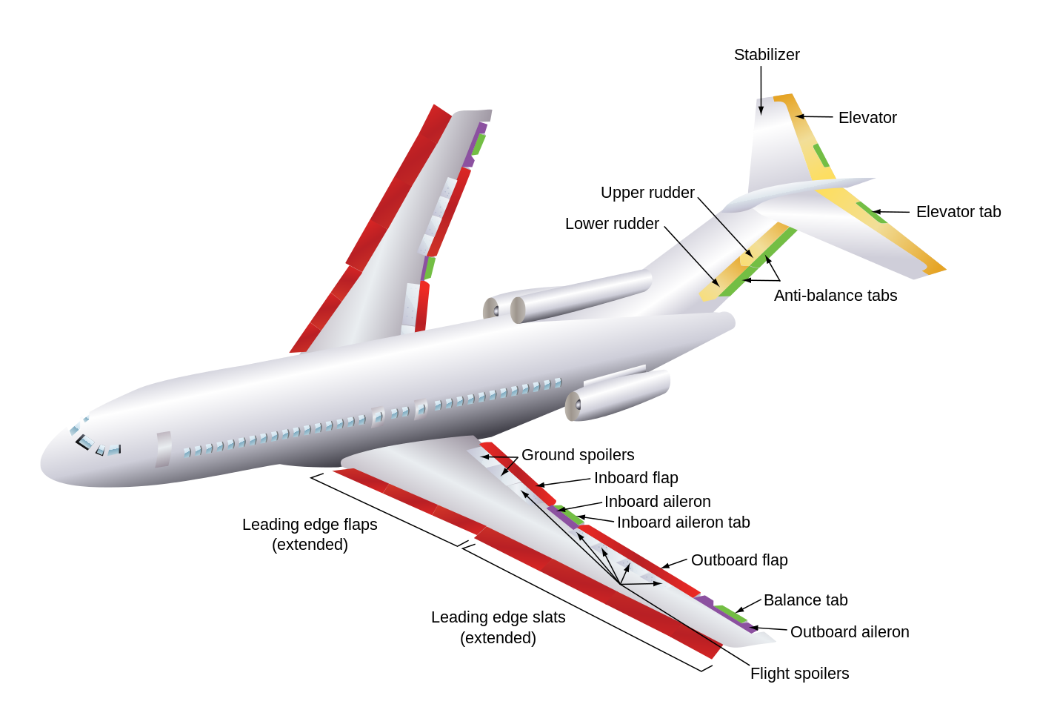
//PLANE CONTROLS
[PRIMARY CONTROL SURFACES]
AILERONS (ROLL) <YOKE / STICK>
RUDDER (YAW) <FOOT PEDALS> Rudder + Ailerons to properly turn plane
ELEVATOR (PITCH) <YOKE / STICK> Main purpose is to change the angle of attack
[SECONDARY & TRIM CONTROL SURFACES]
FLAPS - Increase descent angle without increasing airspeed.
TRIM TABS - Provide force to hold elevator.
Elevator: PITCH
Pitch TRIM Tabs
Rudder: YAW
Yaw TRIM Tabs
Spoiler: BRAKES
Roll TRIM Tabs
Flap: LIFT & DRAG
Aileron: ROLL
PLANE
Slat: LIFT
flightsimpics.com

Slide 5
Elevator: PITCH
Pitch TRIM Tabs
Rudder: YAW
Yaw TRIM Tabs
Spoiler: BRAKES
Roll TRIM Tabs
Flap: LIFT & DRAG
Aileron: ROLL
PLANE
Slat: LIFT

Slide 6
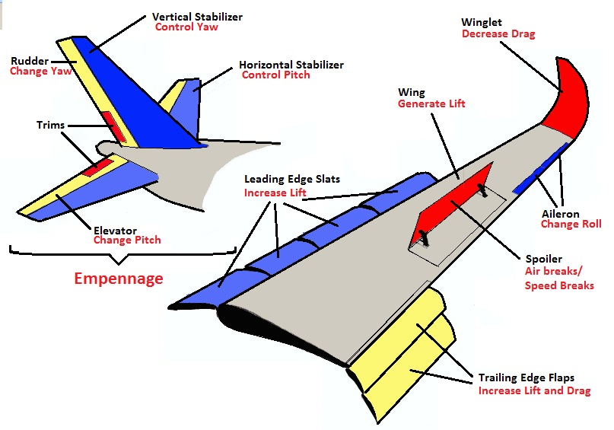
????????

Slide 7
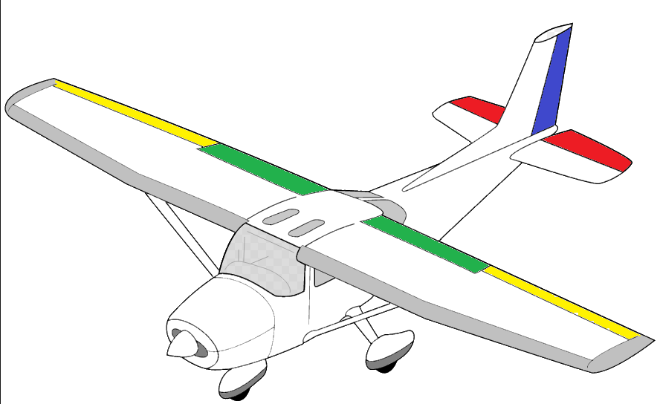
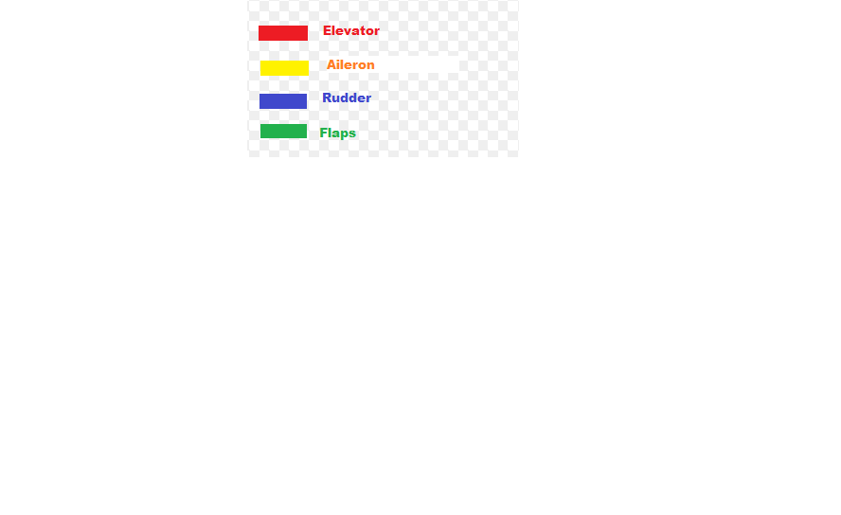
????????

Slide 8
????????

Slide 9
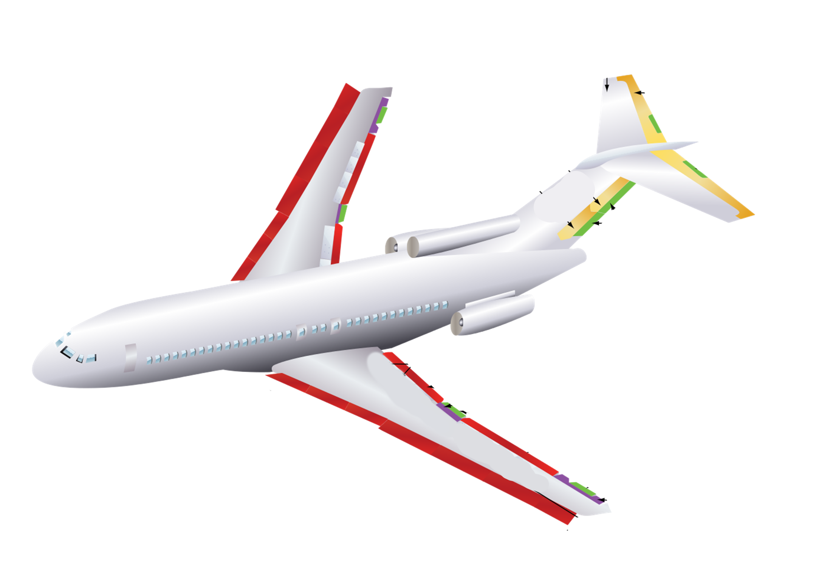

Slide 10
Brakes & Lights
Flight Controls
Pause & Menu
Throttle
FLYING

Slide 11
CAMERA

Slide 12
CAMERADRONE

